Slide 1
Mechanical Prototyping
(Rapid Prototyping)
Final Presentation
PPT for final Mechanical Prototyping Exam Submission

Slide 2
Heat and Stir Mug
Group Members:
Roll No. | Name of student | Exam Seat No.
131 | Vitthal Sai Kaul | S204007
132 | Shubham Kendre | S204006
137 | Karanjot Singh | S204001
140 | Kshitija Lade | S204016
144 | Viraj Yadav | S204121
217 | Vaishnavi Jadhav | S204052

Slide 3

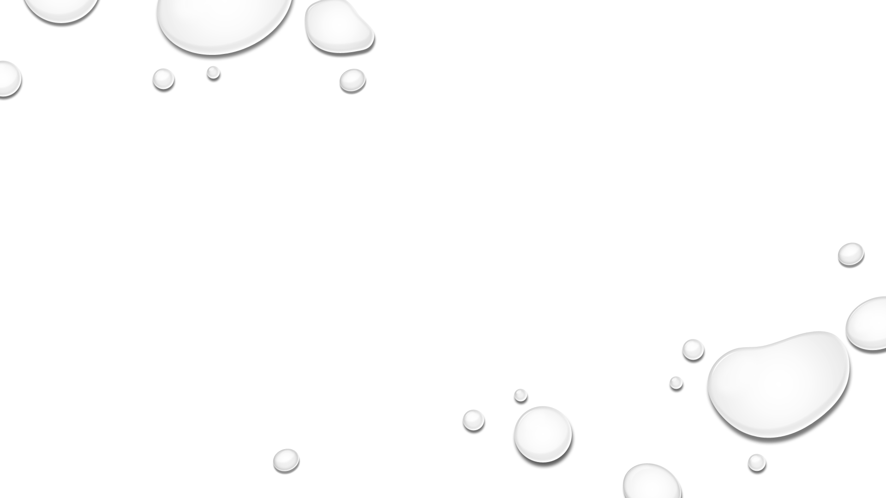
INTRODUCTION
Self Stirring and Heating Mug is an innovative product which helps to make hot beverages like tea or coffee or even fast foods like noodles or soups within seconds as heating and stirring can be carried out simultaneously.
It is a top quality stainless steel thermal mug and as a result, keeps heated liquid warm and cold liquids cold with the help of a lid.
The mug is easy to use, durable and premium quality with a strong and sturdy handle with two buttons, one for heating and one for stirring.
It is sleek and professional looking and great for broad uses like for home or office purposes.

Slide 4
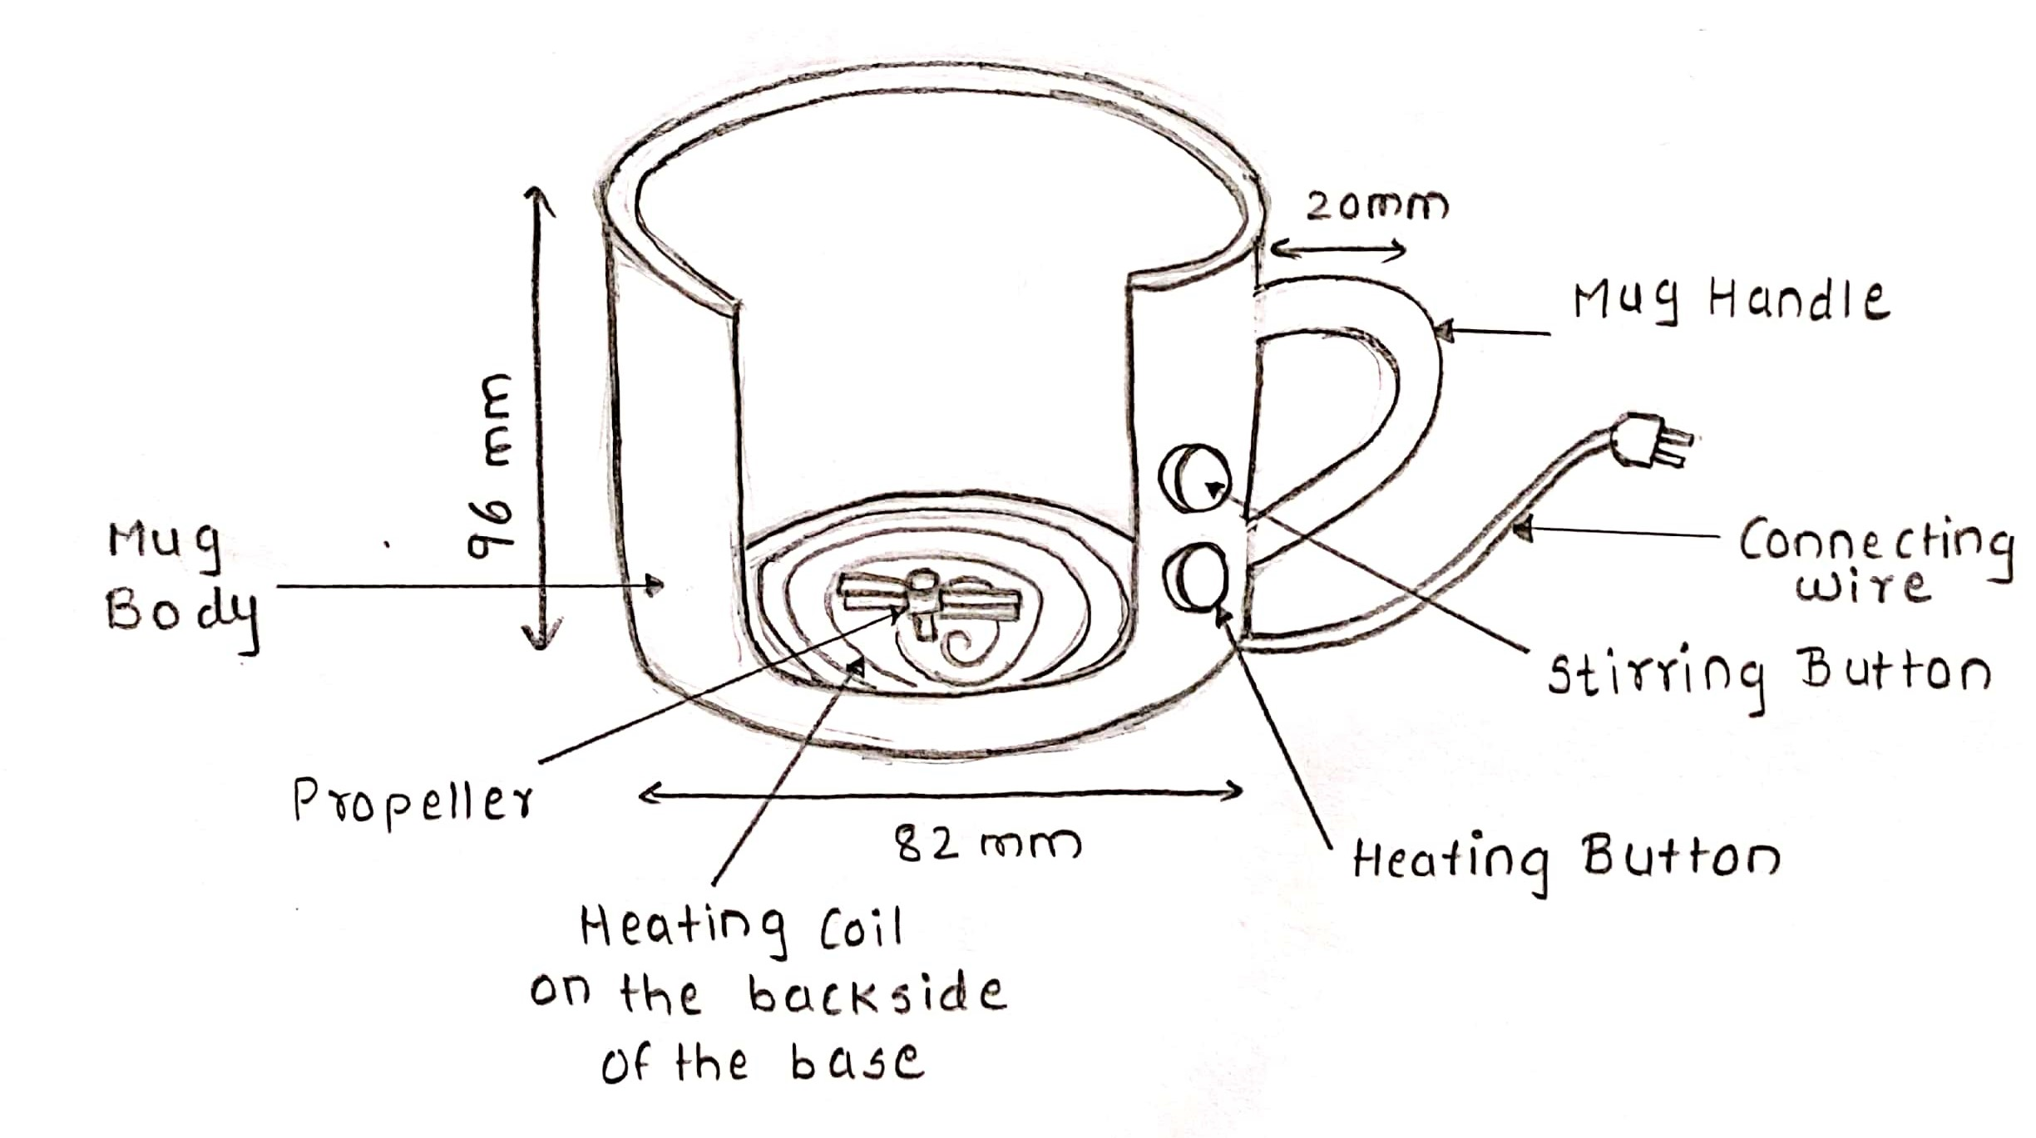
Concept drawing (Rough sketch idea):-

Slide 5
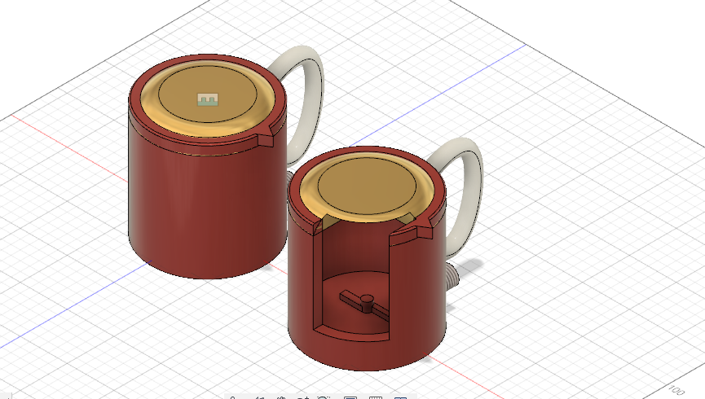
3D modeling creative product
1. CAD Model

Slide 6

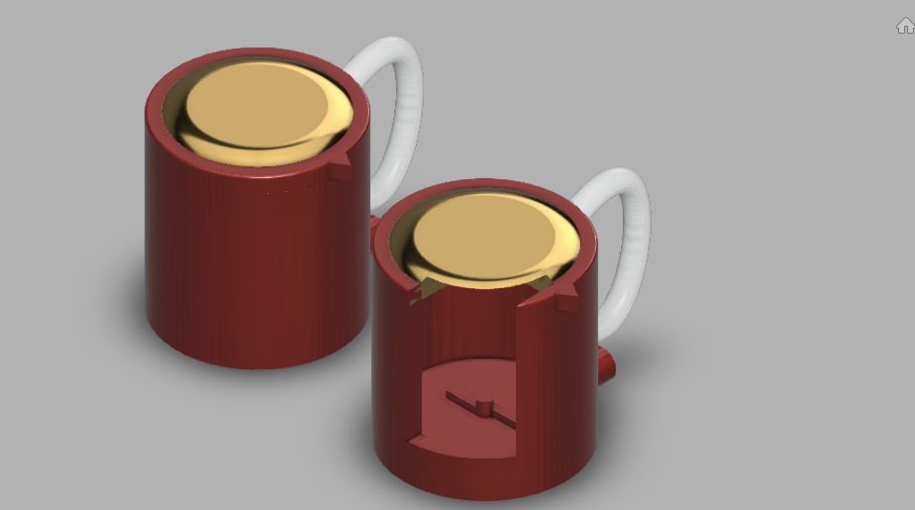
1. CAD Model

Slide 7
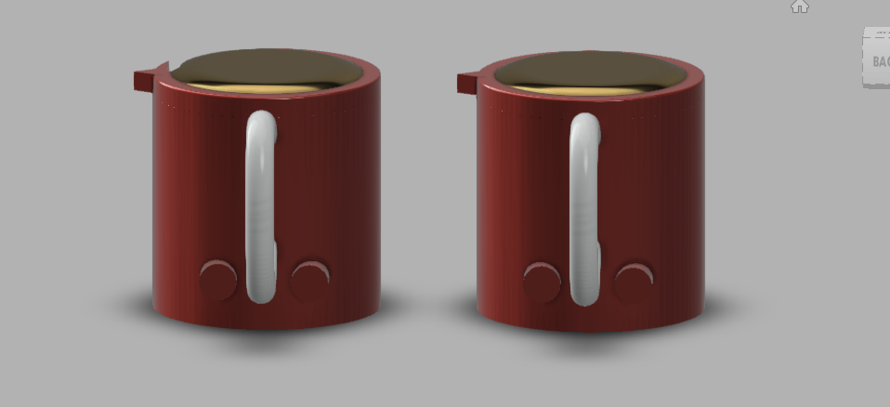
1. CAD Model

Slide 8
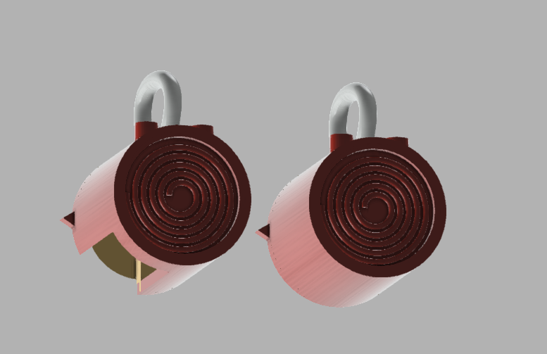
1. CAD Model

Slide 9
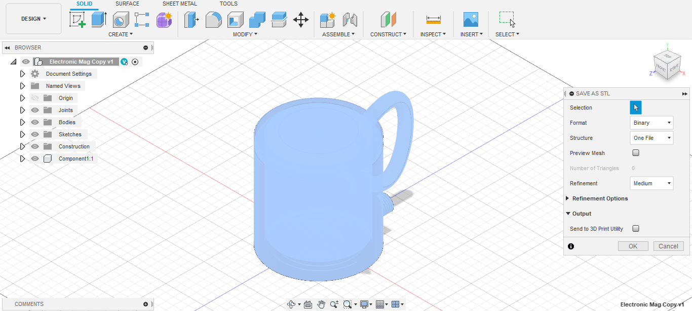
2. .STL FORMATION

Slide 10
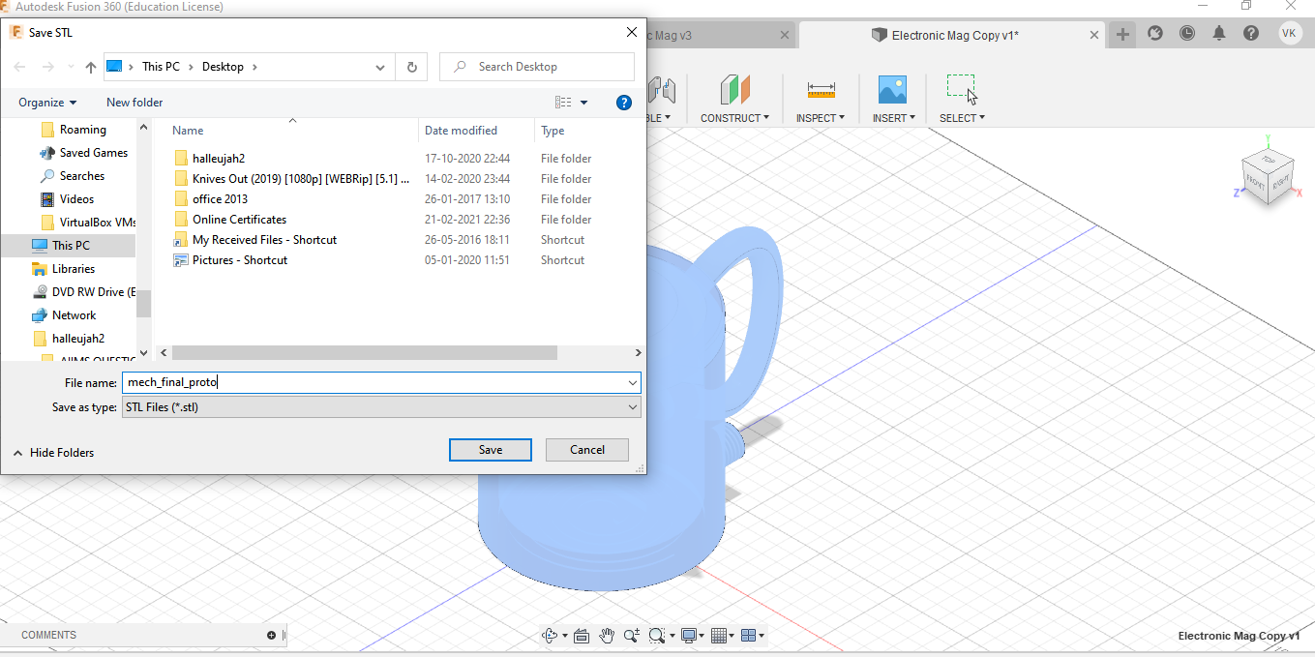
3. STL Formation

Slide 11
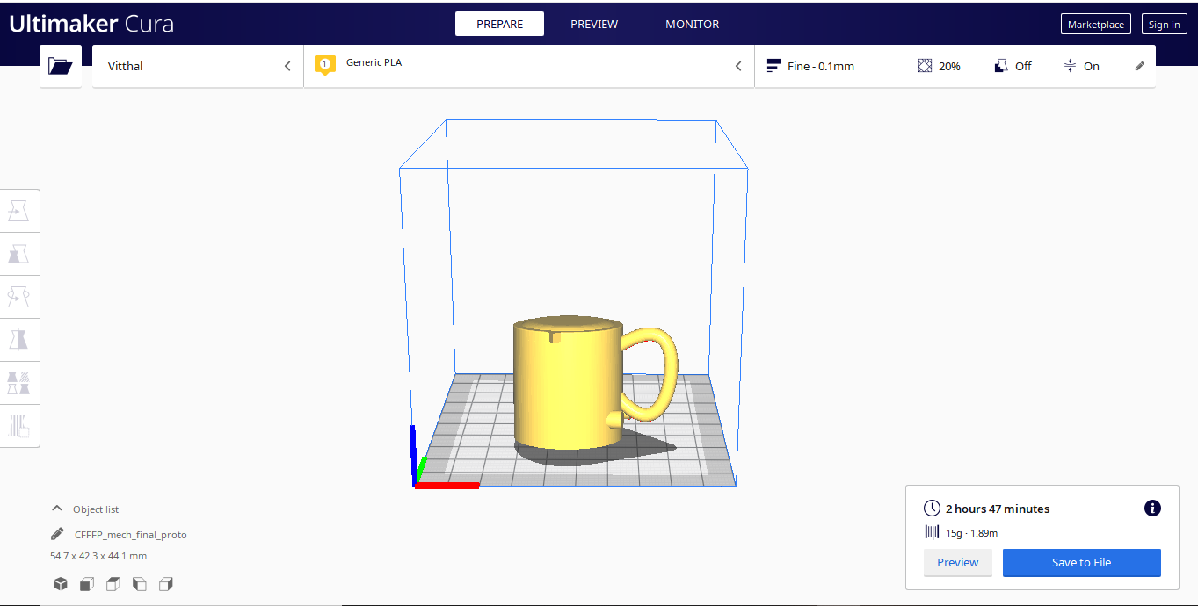
3. Slicing of model in Cura
With default setting Slicing time is : 2 Hrs 47 mins

Slide 12
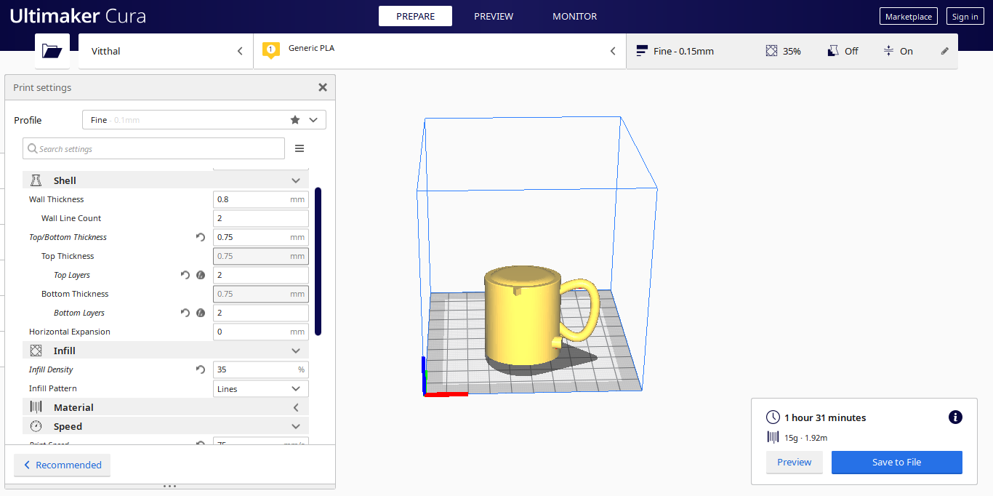
3. Slicing of model in Cura
After changing the setting Slicing time is : 1hr 37 mins

Slide 13
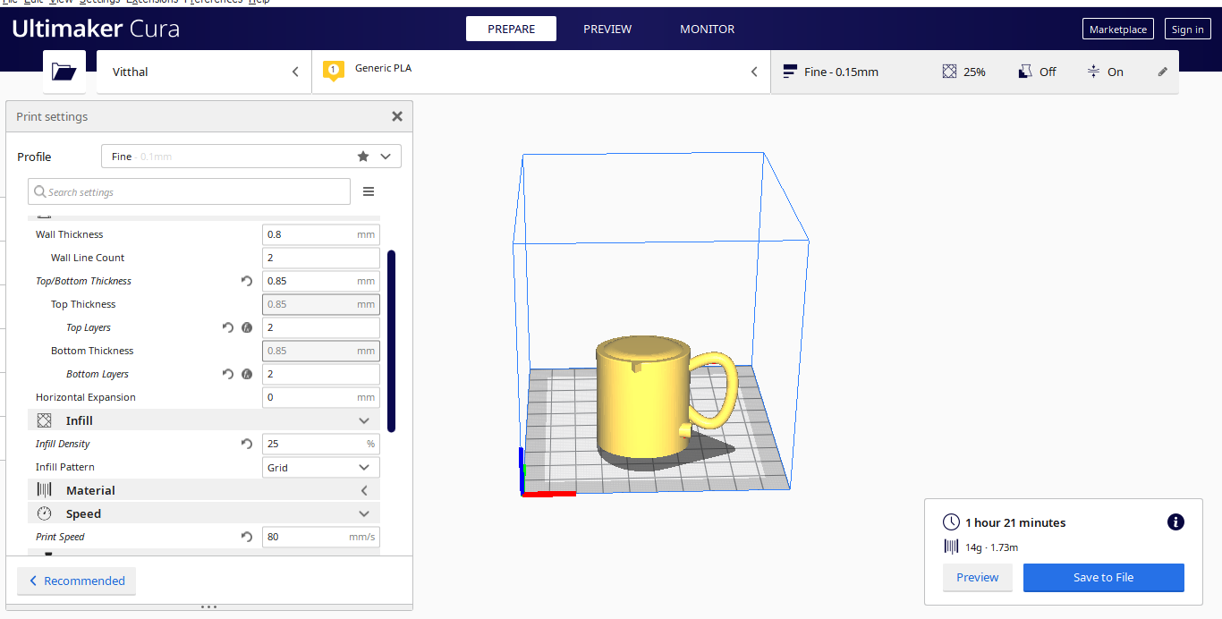
3. Slicing of model in Cura
After changing the setting Slicing time is : 1hr 21 mins

Slide 14
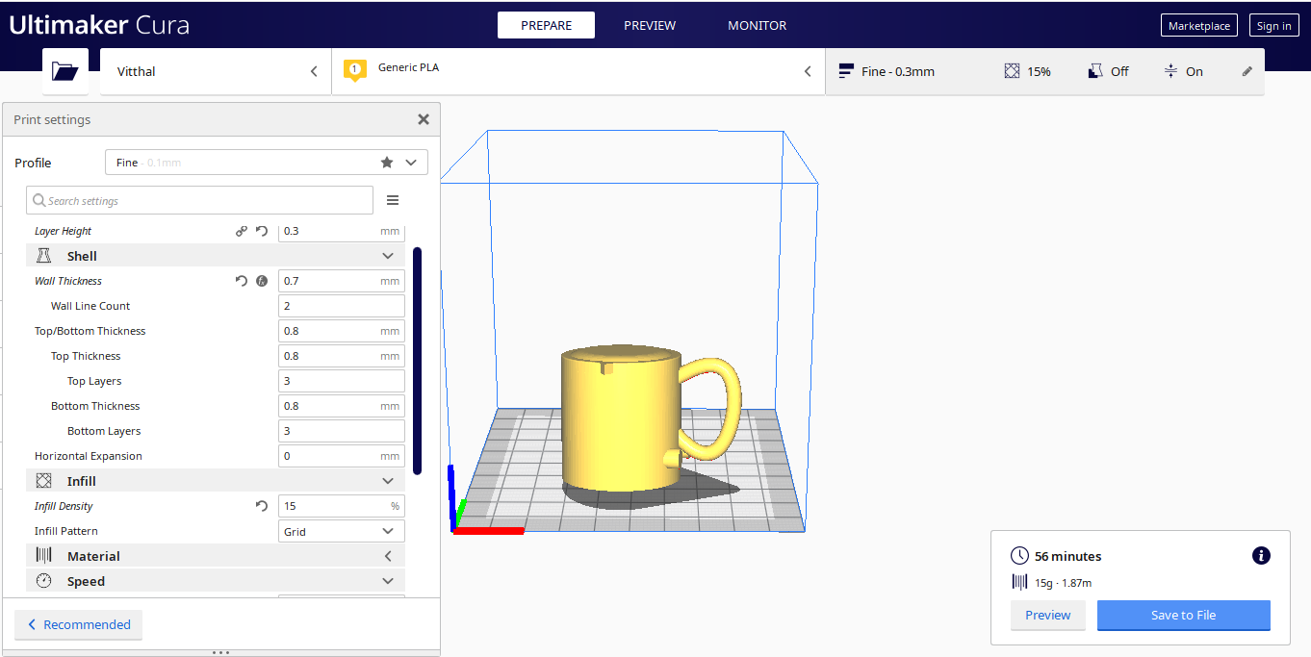
3. Slicing of model in Cura
After changing the setting Slicing time is : 56 mins

Slide 15
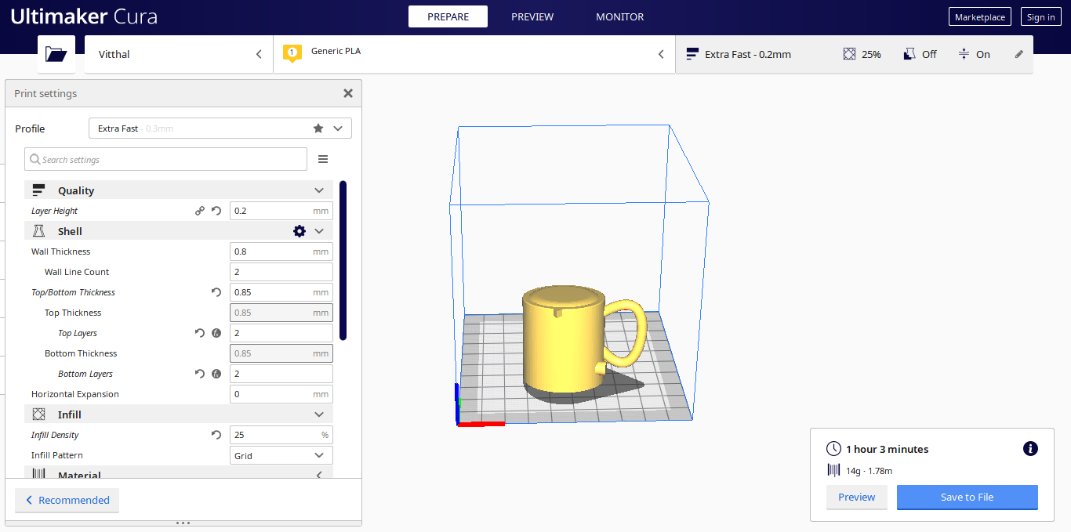
3. Slicing of model in Cura
After changing the setting Slicing time is : 1hr 3 mins

Slide 16
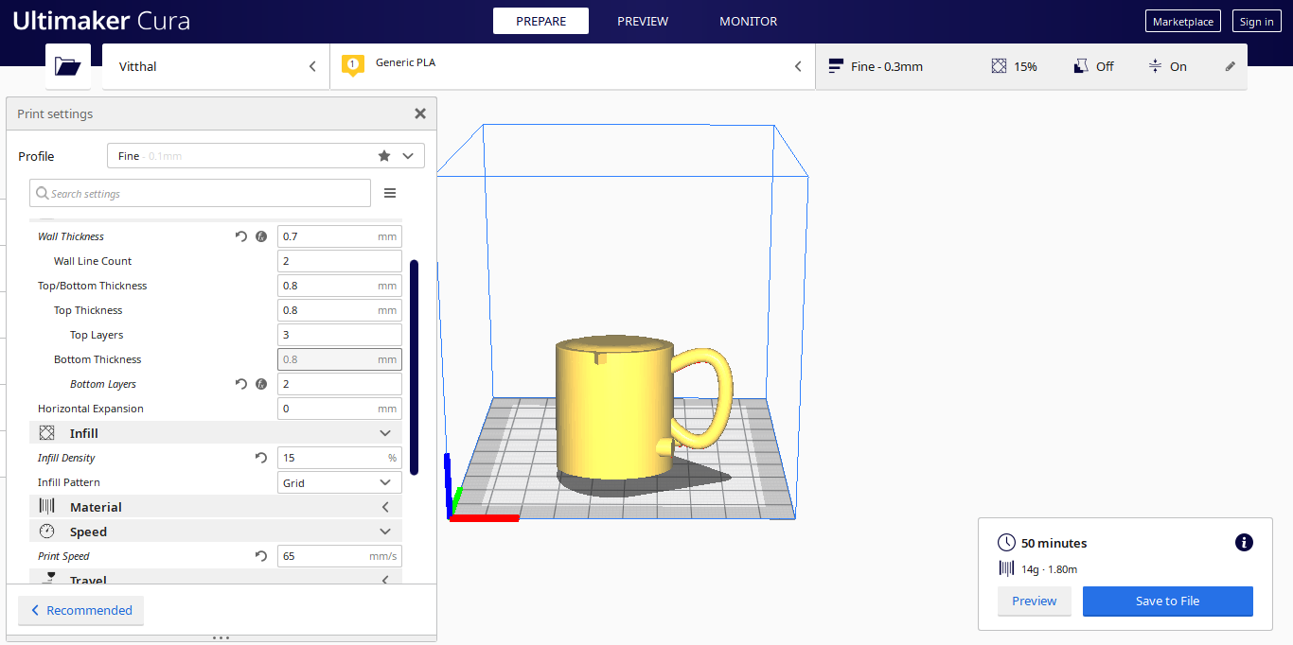
3. Slicing of model in Cura
After changing the setting Slicing time is : 50 mins

Slide 17
Applications of product
Making coffee or tea
Heating foods
Making soups or noodles
Preparing instant food
Frying
Stirring sugar in liquids
Useful in the situations when user doesn’t have utensils to prepare the food.

Slide 18
Advantages
It saves time as well as hand engagement
You do not have to carry & clean the spoons
It is highly portable & easy to carry around, between home and work or other places
As stainless steel is used, it maintains the temperature of the liquid for a long time
It mixes solute & solvent particles very well so you have none left at the bottom
No hassle

Slide 19
Limitations
As it needs electricity to work, so the user cannot use it all the time
Due to the size limitation, a normal amount of drink can be made for a single person only
As it is fully electrically, so washing our product may be perform on a difficult note

Slide 20
Bill of Materials
S.no | Item | Cost of Final Product
1. | Cost of Material (Weight x price) | ₹ 1120/kg* 400 gm = ₹450
2. | Cost of 3D Printer (2/- per minute) | ₹ 50*2 = ₹100
3. | Fees or Charges of CAD Designer (students has to decide charges for product development) | ₹500
4. | Crapes if any | NIL
5. | Miscellaneous expense (Other expense) | ₹15
Total |  | ₹ 1065

Slide 21
Conclusion
To conclude, we have designed our innovative product i.e Self Stirring and Heating Mug under the guidance of Mr. Amol Kolhe. Our product can be used to make any hot beverages and fast foods like noodles for a single person. Like a good team, we have started from scratch( rough sketching) to final cad designing of our product and discussed some applications, advantages and a few limitations of our product. We have learnt a lot of new things during working on this project under the pandemic.

Slide 22
References
https://www.youtube.com/
https://all3dp.com/1/cura-tutorial-software-slicer-cura-3d/
https://www.instructables.com/Intro-to-3D-Modeling/
https://www.researchgate.net/publication/322396217_Smart_Travel_Mug_for_Hot_and_Cold_Beverages
https://en.wikipedia.org/wiki/Main_Page

Slide 23
THANK :) YOU

